Slide 1

SALES AND FINANCIAL DASHBOARD
Tool: Power BI
Dataset: Financial Sample Data
Created by: Yashvi Patel

Slide 2
Project Objective
To build an interactive dashboard that helps business stakeholders analyze sales performance across products, regions, and time.

Slide 3
KPIs Used
Total Sales
Profit & Margin
Monthly Trends
Top Products
Branch-wise Performance

Slide 4
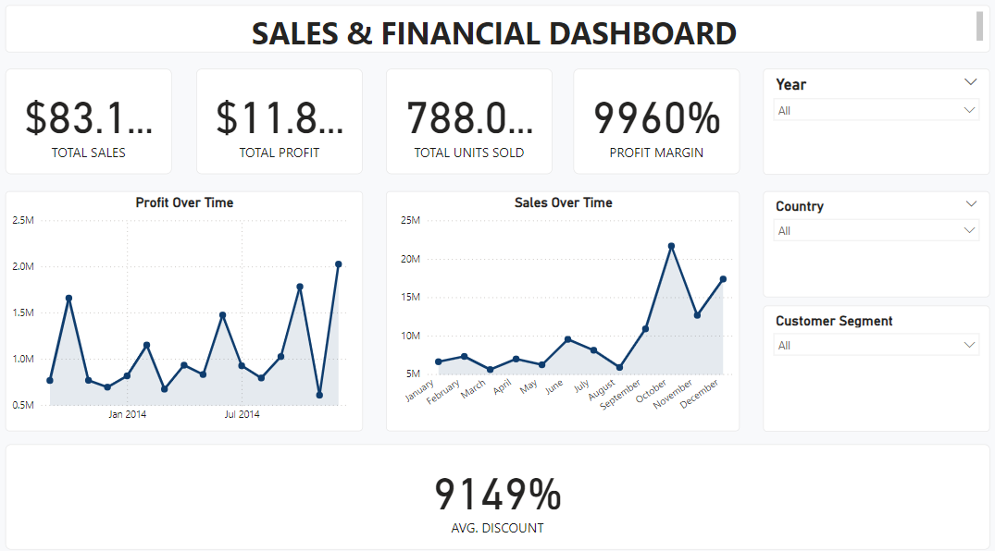
Dashboard Screenshot

Slide 5

Key Insights
📈 Most sales: June
🏆 Top country: Mexico
⚠️ Least profit: Amarilla

Slide 6
Recommendations
Promote high-selling products in other countries
Investigate low margin in Amarilla
Expand marketing efforts in Mexico

Slide 7

Features Used
Power BI visuals: Line, Card, Slicer
Interactive filters and navigation
Consistent theme and color palette

